Slide 1
Detection of Spoiled Meat to Prevent Foodborne Illness
Group 6
NGUYEN THUY HANH DUYEN
QIU RUILIU
SAMSON ELIJAH CHUA TAN
TAI WEN WEI
WEN YILIN
Notes:
Good afternoon. My name is David and I am here today, together with my team, will be presenting to you on the topic on Detection of Spoiled Meat to Prevent Foorborne illness

Slide 2
01
Problem Statement
02
Dataset Source
Agenda
03
Results and Findings
04
Conclusion
Notes:
We will start off by sharing on the Problem Statement, followed Dataset Source, Results and Findings, Conclusion.
Let me start off by sharing some basic background information first.

Slide 3
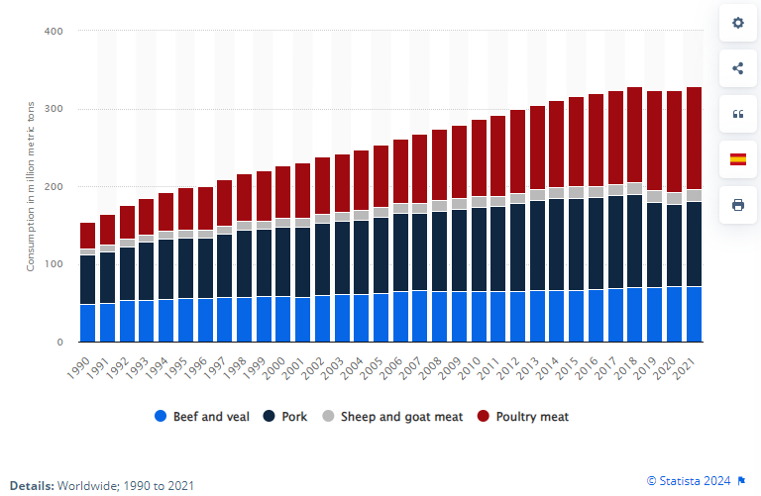
Problem Statement
Global Meat Consumption
1990
150 million MT
2020
350 million MT
Source: Global meat consumption by type | Statista (smu.edu.sg)
Est. 600 million – almost 1 in 10 people in the world – fall ill after eating contaminated food & 420,000 die every year
Meat freshness is an important indicator of the quality & the safety of meat products
Traditional methods used for determining meat freshness include sensory evaluations. However, it cannot be used for online measurement due to subjectivity
Source: Food safety (who.int)
Source: A Comprehensive Method for Assessing Meat Freshness
Notes:
Do you know that for global meat consumption; it has increased over 2x the amount to 350 million MT in 2020.
However, do you know that there are 600 million people fall ill after eating contaminated food, resulted in half a million death on a yearly basis?
Thus, ensuring meat freshness becomes an important indicator of food quality and safety.
Traditional methods such as sensory evaluations cannot be used as it is subjective.
Salmonella, Campylobacter and enterohaemorrhagic Escherichia coli are some of the most common foodborne pathogens that affect millions of people annually, sometimes with severe and fatal outcomes. Symptoms can be fever, headache, nausea, vomiting, abdominal pain and diarrhoea. Foods involved in outbreaks of salmonellosis include eggs, poultry and other products of animal origin.
CAGR growth = 2.89%

Slide 4
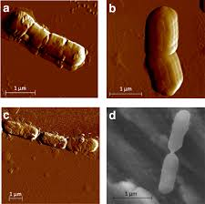
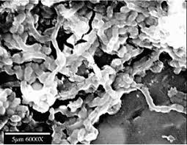
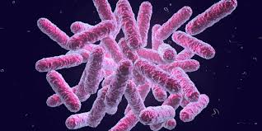
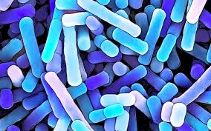

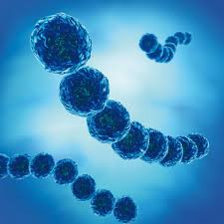
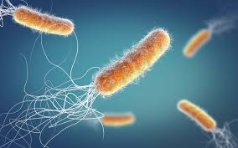
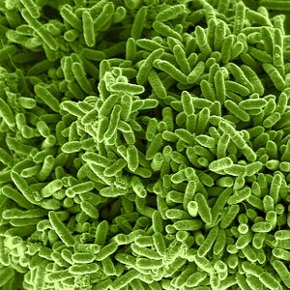
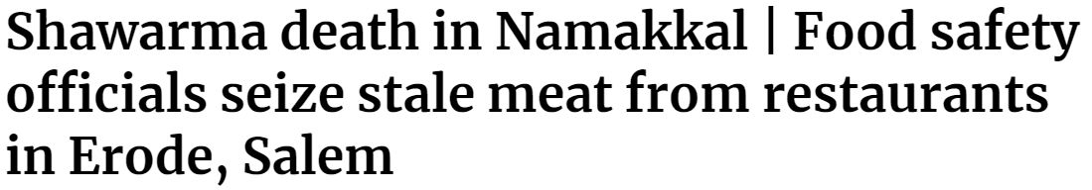
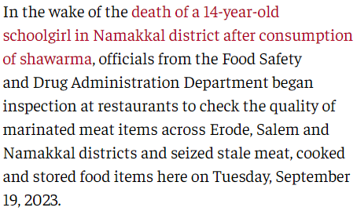
Background Information
Bacterial spoilage of meat and cured meat products
Brochothrix thermosphacta
Carnobacterium spp.
Enterobacteriaceae
Lactobacillus spp.
Spoiled Meat
Leuconostoc spp.
Pseudomonas spp.
Shewanella putrefaciens.
Source: Bacterial spoilage of meat and cured meat products - ScienceDirect
Symptoms
Higher Risk Group
Diarrhoea
Fever
Belly Cramps
Young Children
Older Adults
Nausea
Vomiting
Headache
Pregnant Women
Chronic Diesease
Source: Food Poisoning | Johns Hopkins Medicine
Source: Shawarma death in Namakkal (Sept 2023)

Slide 5
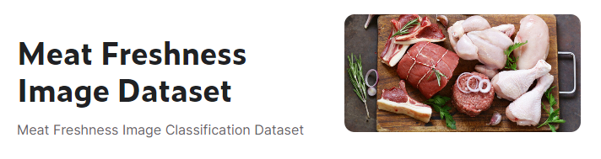
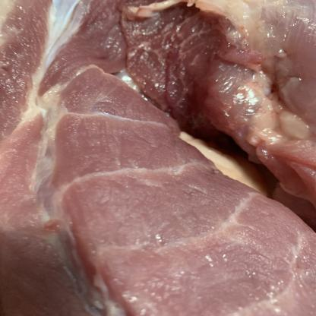
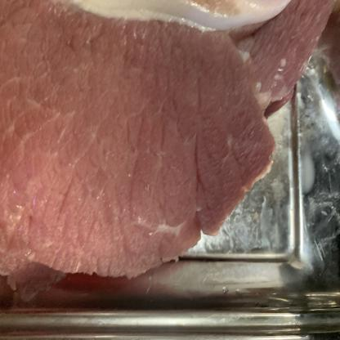
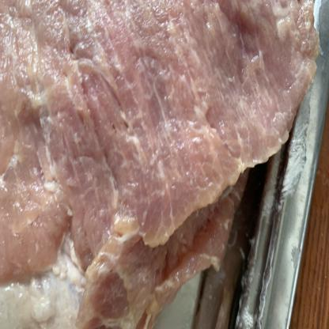
Dataset Source
Training Set (80%) 1,816 labelled images
Validation Set (20%)
452 labelled images
Source: Meat Freshness Image Dataset (kaggle.com)
Classification
Fresh
Half Fresh
Spoiled
Fresh
Half-Fresh
Spoiled
Notes:
Based on these 3 images, are you able to tell which is fresh, half-fresh and spoiled?
Lets take 10 seconds to predict based on what we see.

Slide 6







Approach
Image Classification
Tools
Logistic Regression
Naïve Bayes Classifier
Random Forest
Artificial Neural Network
Convolutional Neural Network

Slide 7

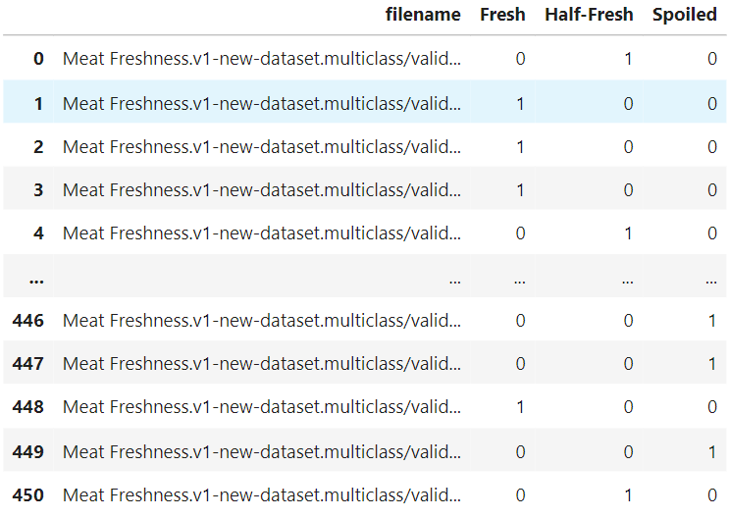
Image Preprocessing
2268 Images
416 x 416 x 3 (RGB)
853 Fresh | 789 Half-Fresh | 624 Spoiled
37% | 35% | 28%
Create a DataFrame with file path & label
Feed the DataFrame into an Image Data Generator (Keras Library)
Convert images to PIL (numerical format)
Perform image augmentation in batches
Rescale pixel values from [0,1]
Resize images to 224x224
DataFrame used in the Keras Image Generator
Notes:
In your case, the problem with setting the shuffle=True is that if you shuffle on your validation set, the results will be chaotic. It happens that the prediction is correct but compared to wrong indices can lead to misleading results, just like it happened in your case.
Always shuffle=True on the training set and shuffle=False on the validation set and test set.

Slide 8
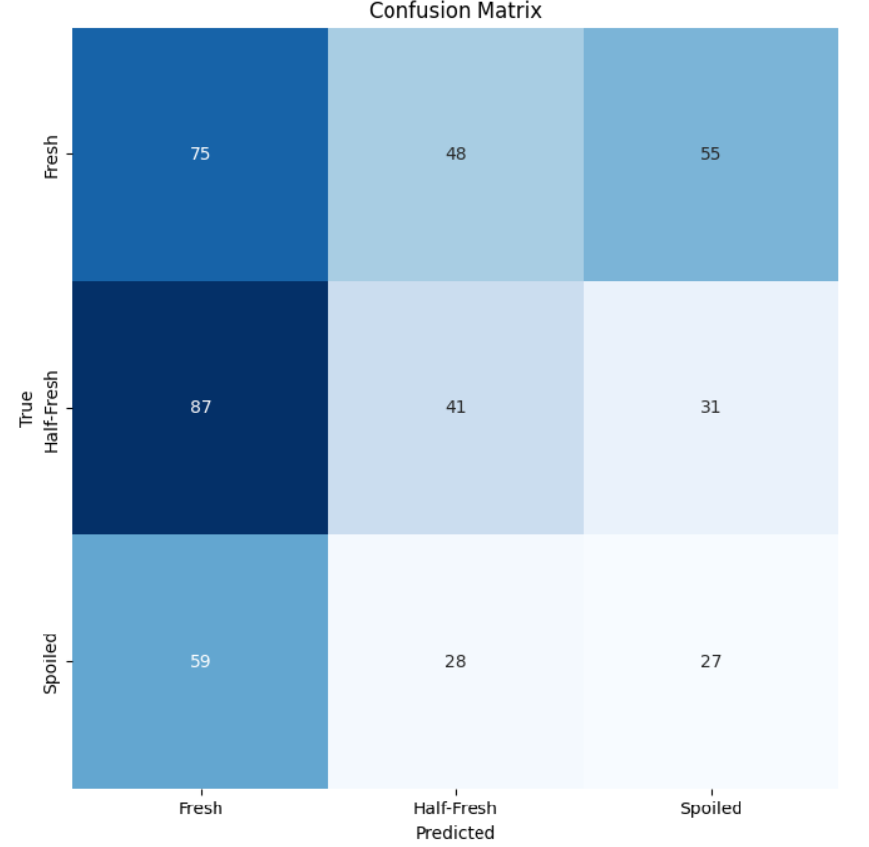
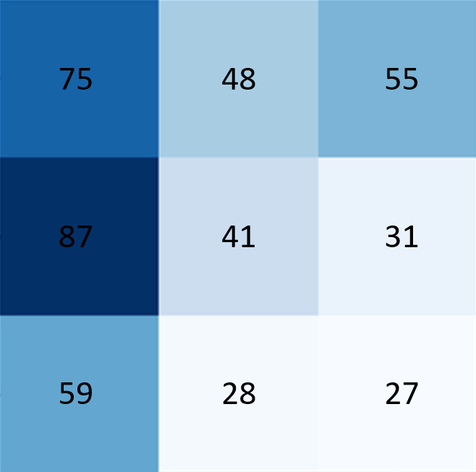
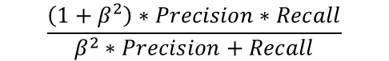
Performance Metrics
It is important that the model minimizes inaccurate predictions, specifically in the case where it classifies the meat to be ‘Fresh’, but is actually ‘Spoiled’ (False Negative)
Emphasis more on recall than precision
Objective: Minimize False Negatives
F3 Score
$$\frac{\left(1+β^{2}\right)∗Precision∗Recall}{β^{2}∗Precision+Recall}$$
Set β = 3 to give more weightage on recall
Notes:
In your case, the problem with setting the shuffle=True is that if you shuffle on your validation set, the results will be chaotic. It happens that the prediction is correct but compared to wrong indices can lead to misleading results, just like it happened in your case.
Always shuffle=True on the training set and shuffle=False on the validation set and test set.

Slide 9
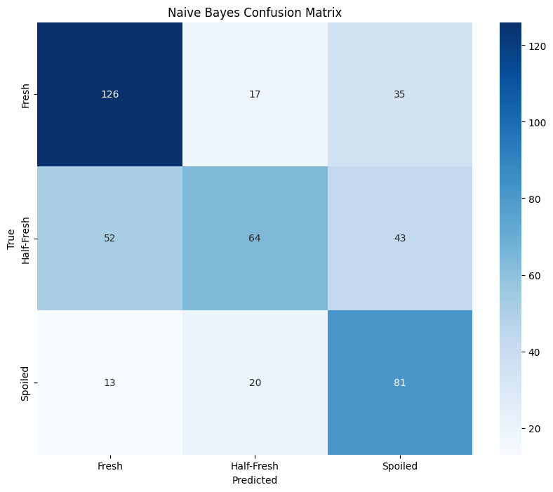
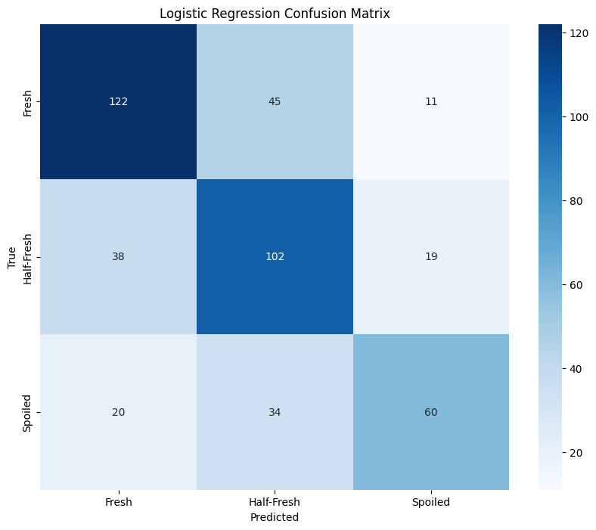
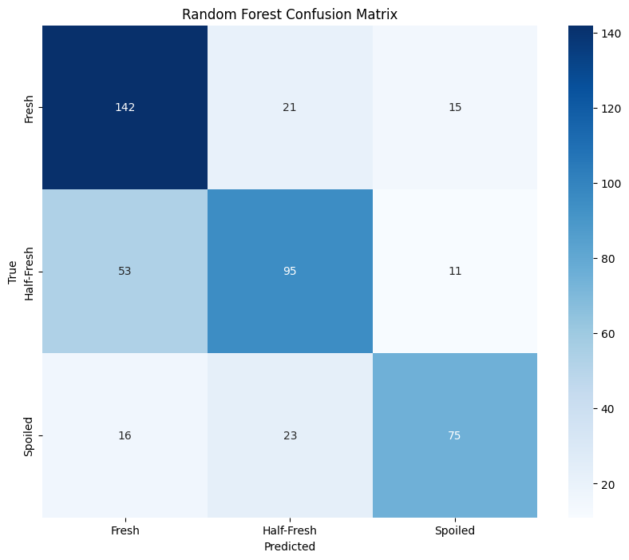
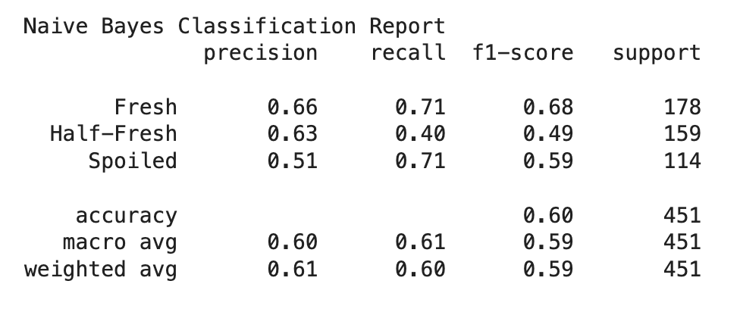
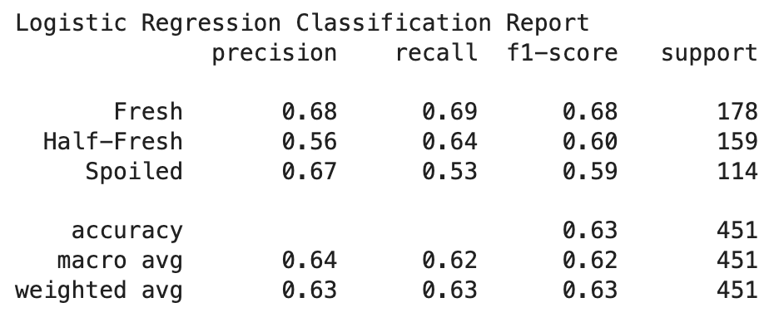
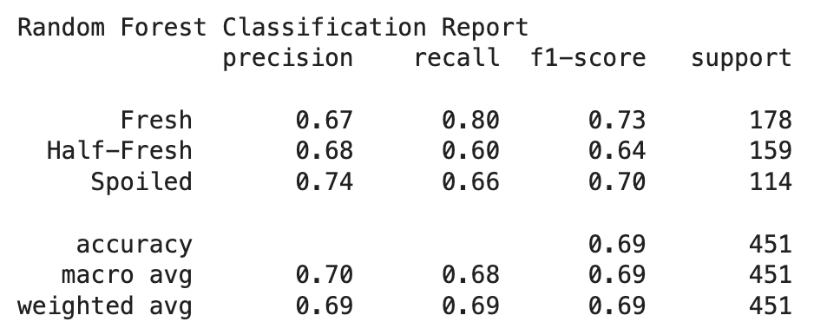
Model Selection and Performance (Traditional Model)
Naïve Bayes
Logistic Regression
Random Forest
F3 Score
NB assumes that all features are independent
F3 Score
LR expects a linear decision boundary to separate classes
F3 Score
RF struggle with making effective splits that classifies classes
0.68
0.54
0.67
Notes:
NB assumes that all features are independent, which is not true for images, where pixels are highly correlated
LR expects a linear decision boundary to separate classes, therefore cannot capture the complex or non-linear relationship of the Meat images
RF struggle with unstructured nature of images – pixel values offer little predictive power for making effective splits that classifies Spoiled or Fresh meat

Slide 10
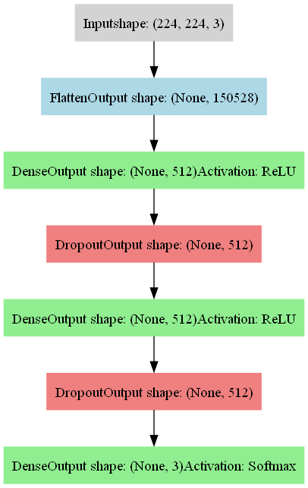
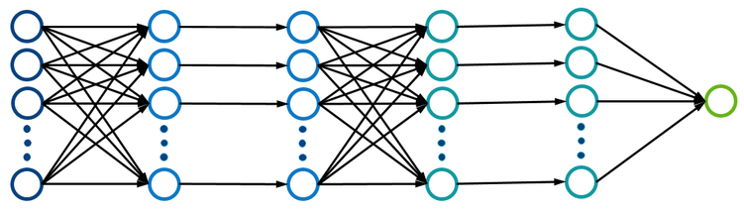
ANN Architecture
224x244x3
512
512
3
Input Layer
Hidden Layer
Dropout
Hidden Layer
Dropout
Output
relu
0.2
relu
0.2
softmax
Optimizer | Loss | Metrics
Adam | Categorical Cross Entropy | Accuracy

Slide 11
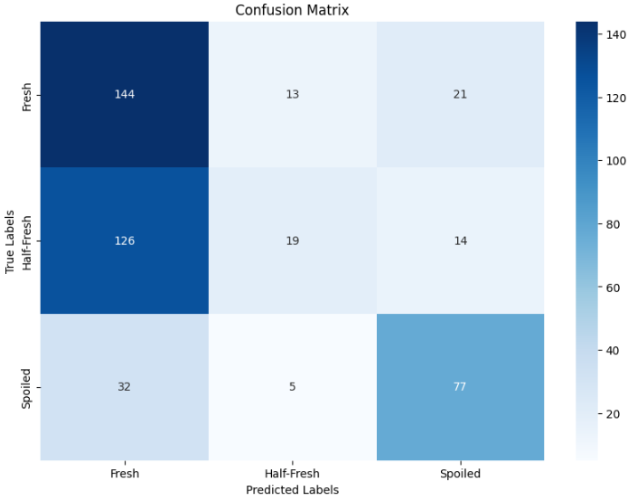
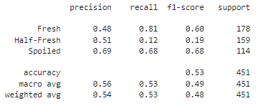
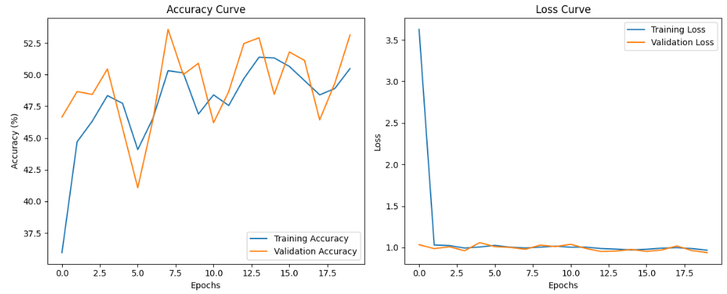
Model Selection and Performance (Self-Built ANN Model)
F3 Score
0.68
Epochs: 20
Dropout: 0.2
Activation: ReLu
Optimizer: Adam

Slide 12
CNN Architecture
keras.layers.Conv2D
32 filters
padding
3x3 kernels
64 filters
padding
3x3 kernels
Output
Input
224x224x3
Conv2D
+ Relu
Conv2D
+ Relu
Flatten
Softmax
3 classes
Max Pooling
(2 x 2)
Max Pooling
(2 x 2)
Fresh
Dropout
Dropout
Half-Fresh
Spoiled
Conv2D: 2D images
Max Pooling: Reduces spatial dimensions by taking the maximum value in each patch of the feature map, aiding in dimensionality reduction and computational efficiency.
Random Dropout: A regularization technique where randomly selected images are ignored during training to prevent overfitting.
Filter: Determines the number of output feature maps produced by the convolutional layer.
Padding ('valid'): No padding is added to the input image, meaning the output size is smaller than the input size due to the convolution operation
Kernel_size: Specifies the height and width of the 2D convolution window (e.g., 3x3, 5x5).
Notes:
Model Summary Breakdown:
Input Layer:
Input shape: (224, 224, 3) - Images with dimensions 224x224 and 3 color channels (RGB).
First Convolutional Layer:
Conv2D: 32 filters, 3x3 kernel size, ReLU activation.
Output Shape: (None, 222, 222, 32)
Parameters: 896
Second Convolutional Layer:
Conv2D: 64 filters, 3x3 kernel size, ReLU activation.
Output Shape: (None, 220, 220, 64)
Parameters: 18,496
Pooling Layer:
MaxPooling2D: Pool size of 2x2.
Output Shape: (None, 110, 110, 64)
Parameters: 0
Dropout Layer:
Dropout: 0.2 (20% of the nodes will be dropped randomly during training to prevent overfitting).
Output Shape: (None, 110, 110, 64)
Parameters: 0
Flatten Layer:
Flatten: Converts the 3D output to 1D.
Output Shape: (None, 774400)
Parameters: 0
First Dense Layer (Fully Connected Layer):
Dense: 128 units, ReLU activation.
Output Shape: (None, 128)
Parameters: 99,123,328
Second Dropout Layer:
Dropout: 0.2
Output Shape: (None, 128)
Parameters: 0
Output Dense Layer:
Dense: 3 units, Softmax activation (for classification into 3 classes).
Output Shape: (None, 3)
Parameters: 387
Filter: The number of output filters in the convolution.
Explanation: This determines the number of feature maps produced by the convolutional layer. Each filter detects a different feature in the input image.
Explanation: 'Same' padding means that the output size is the same as the input size. Padding with zeros ensures that the convolutional filter can cover the entire image, including the edges.
Kernel_size: Height x width of the 2D convolution window.
Explanation: The dimensions of the convolution filter. Common sizes are 3x3, 5x5, etc. This determines the region of the input image that the filter covers.
Explanation: This is a method of initializing the weights of the network, designed to help deep neural networks converge faster. The weights are drawn from a truncated normal distribution with a mean of 0 and a standard deviation of 2/number of input units\sqrt{2 / \text{number of input units}}2/number of input units .
Conv2D: 2D images.
Explanation: This refers to a 2D convolutional layer that processes 2D input images to produce 2D output feature maps.
Max pooling:
Explanation: A pooling layer that performs downsampling by taking the maximum value in each patch of the feature map. It helps to reduce the spatial dimensions and computational load.
Random Dropout:
Explanation: A regularization technique where randomly selected neurons are ignored (dropped out) during training. This helps to prevent overfitting by ensuring that the network does not rely too heavily on any single neuron.

Slide 13
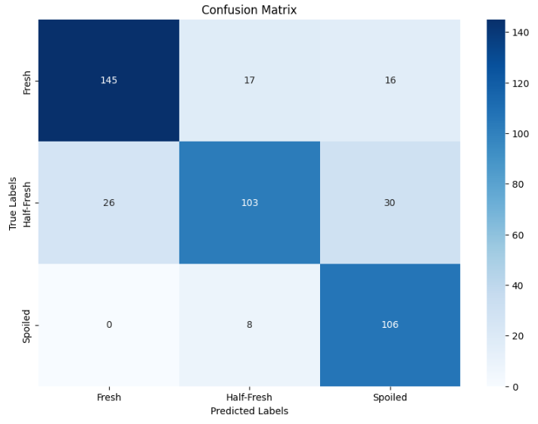
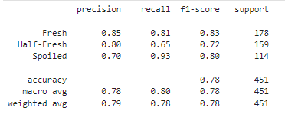
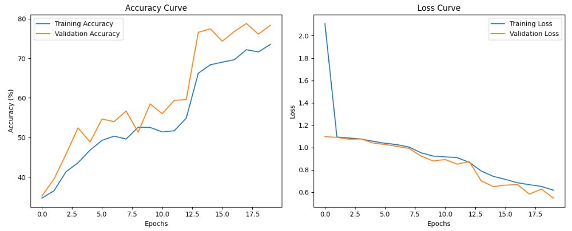
Model Selection and Performance (Self-Built CNN Model)
F3 Score
0.90
Epochs: 20
Dropout: 0.2
Activation: ReLu
Optimizer: Adam

Slide 14
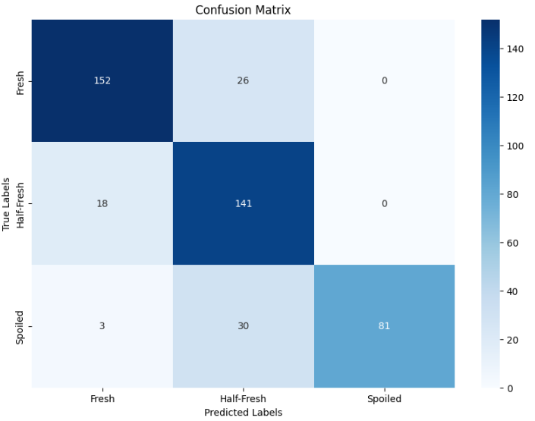
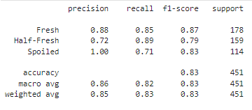
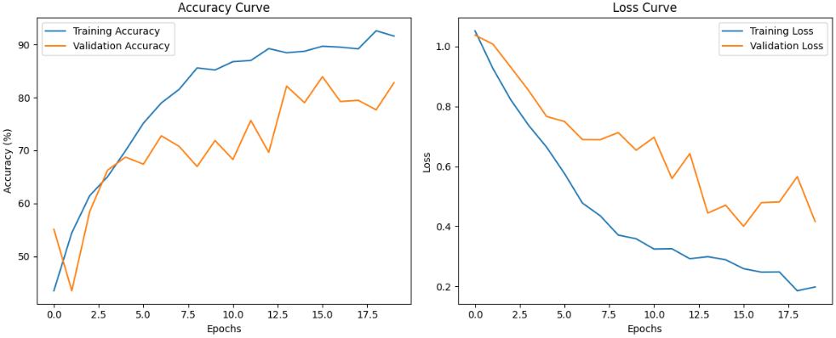
Model Selection and Performance (Self-Built CNN Model – Tuned Parameters)
F3 Score
0.73
Epochs: 20
Dropout: 0.2
Activation: ReLu
Optimizer: Adam

Slide 15
Pre-trained Model Details
Model | Family | # of Layers | # of Parameters | Introduced | Unique Feature
ResNet50 | Residual Network family | 50 | 25.6 million | 2015 | Residual connections to combat vanishing gradients
EfficientNetB0 | EfficientNet family | ~39 | 5.3 million | 2019 | Compound scaling method (width, depth, resolution)
DenseNet121 | DenseNet family | 121 | 8 million | 2016 | Dense connectivity pattern, feature reuse
Xception | Inception family | 71 | 22.9 million | 2017 | Depthwise separable convolutions, improved Inception
VGG16 | Visual Geometry Group family | 16 | 138 million | 2014 | Very deep architecture using small (3x3) convolutions
*A direct comparison is not ideal as each model has a different level of complexity represented through the number of layers and parameters. These pre-trained models were selected arbitrarily based on public popularity.
Notes:
After building our self built ANN/CNN model, we decided to employ 5 pre train models based on public popularity with their attributes and unique feature
ResNet50 is known for its residual connections which effectively combat the vanishing gradients problem, allowing the training of very deep networks.
EfficientNetB0 employs a compound scaling method, which uniformly scales all dimensions of depth, width, and resolution using a set of fixed scaling coefficients. This leads to efficient resource utilization while maintaining high performance.
DenseNet121 is characterized by its dense connectivity pattern, where each layer is connected to every other layer in a feed-forward fashion. This facilitates feature reuse and improves gradient flow.
Xception stands out due to its use of depthwise separable convolutions, which significantly enhance computational efficiency and performance. It can be viewed as an improved version of the Inception architecture.
VGG16 is known for its very deep architecture, constructed using small (3x3) convolution filters. Despite having a large number of parameters, it has been influential in the development of other models.
ResNet models incorporate "skip connections" or "shortcut connections" that allow the input to a layer to be added directly to its output. These connections help solve the vanishing gradient problem by enabling the direct flow of gradients through the network. This architecture allows for much deeper networks by alleviating the problem where additional layers can lead to higher training error when gradients disappear during backpropagation. This key innovation enables training networks with depths of 50 layers and beyond without a degradation in performance.
EfficientNet uses a compound coefficient to uniformly scale network width, depth, and resolution in a principled way. This scaling method is based on a compound coefficient that optimizes the balance between these dimensions to achieve better efficiency and accuracy. Traditional CNNs often scale these dimensions arbitrarily. EfficientNet's approach allows for a more balanced and efficient scaling, leading to smaller and more accurate models that scale well across different hardware and constraints.
In DenseNet architectures, each layer is connected to every other layer in a feed-forward fashion. This means for each layer, the feature maps of all preceding layers are used as inputs, and its own feature maps are used as inputs into all subsequent layers. This dense connectivity pattern promotes feature reuse throughout the network, significantly reduces the number of parameters, and improves the flow of information and gradients throughout the network, which makes the network easier to train

Slide 16
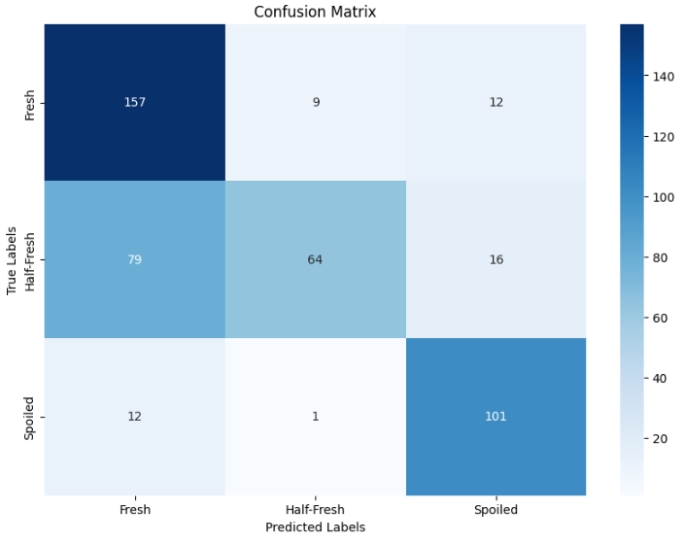
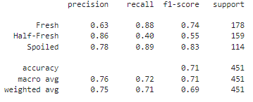
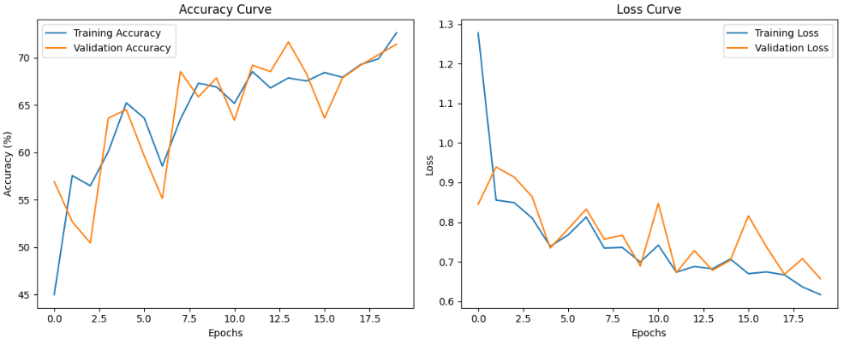
Model Selection and Performance (ResNet 50)
F3 Score
0.88
Epochs: 20
Activation: ReLu
Optimizer: Adam
Notes:
The model performs well in identifying "Fresh" and "Spoiled" classes.
Struggles with "Half-Fresh," with many instances misclassified as "Fresh" or "Spoiled."
Training accuracy and loss improve steadily, indicating good learning.
Validation accuracy and loss fluctuate, suggesting potential overfitting or variability.
False negatives, such as classifying "Spoiled" meat as "Fresh," are particularly harmful in our application, as they pose a risk to consumer health.
Epochs: 20:
The model was trained for 20 epochs, which provided sufficient time for learning without overfitting, as indicated by the stable validation loss.
Activation: ReLU:
ReLU (Rectified Linear Unit) activation function was used, which helps in efficiently training deep networks by mitigating the vanishing gradient problem and introducing non-linearity.
Optimizer: Adam:
The Adam optimizer was chosen for training, known for its adaptive learning rate and efficient performance in handling sparse gradients, leading to faster convergence.
The confusion matrix provides a summary of the classification results:
True Positives (Diagonal elements):
Fresh: 157
Half-Fresh: 64
Spoiled: 101
False Positives and False Negatives (Off-diagonal elements):
Fresh misclassified as Half-Fresh: 9
Fresh misclassified as Spoiled: 12
Half-Fresh misclassified as Fresh: 79
Half-Fresh misclassified as Spoiled: 16
Spoiled misclassified as Fresh: 1
Spoiled misclassified as Half-Fresh: 12

Slide 17
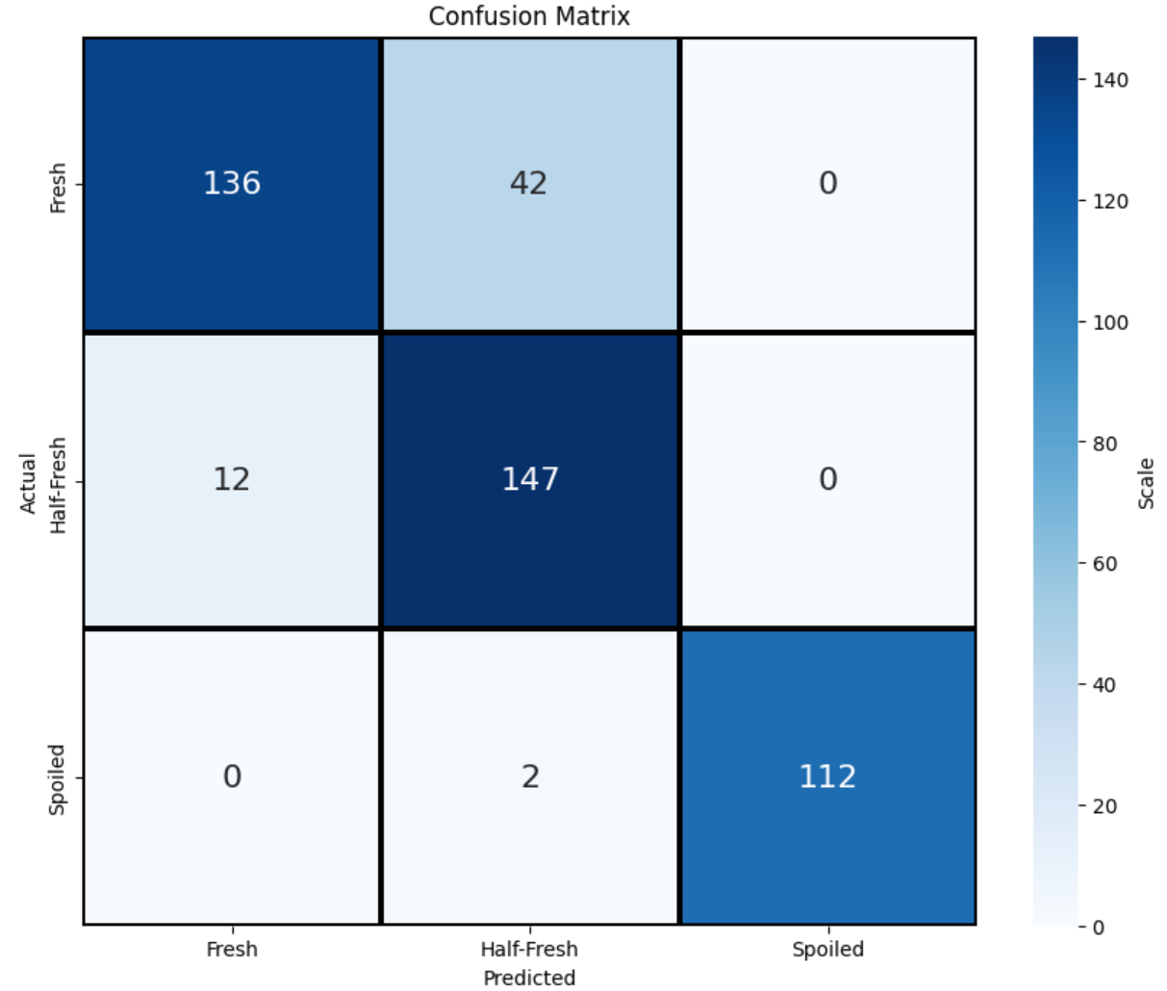
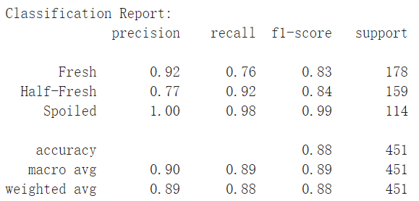
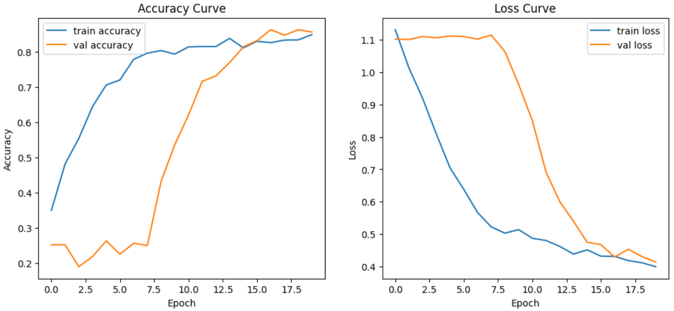
Model Selection and Performance (EfficientNetB0)
F3 Score
0.98
Epochs: 20
Activation: ReLu
Optimizer: Adam
Notes:
The model effectively identifies "Fresh" and "Spoiled" classes with minimal misclassifications.
Some misclassifications occur with the "Half-Fresh" class, where instances are often identified as "Fresh."
F3 score = 0.98 Reflects excellent recall performance, especially important for ensuring the safety and quality of meat classification.
False negatives, such as classifying "Spoiled" meat as "Fresh," are particularly harmful in our application, as they pose a risk to consumer health.
Acuracy curve: Both training and validation accuracy increase steadily, indicating consistent model learning and performance.
Loss Curve: Both training and validation loss decrease, with validation loss stabilizing, suggesting good generalization and minimal overfitting.

Slide 18
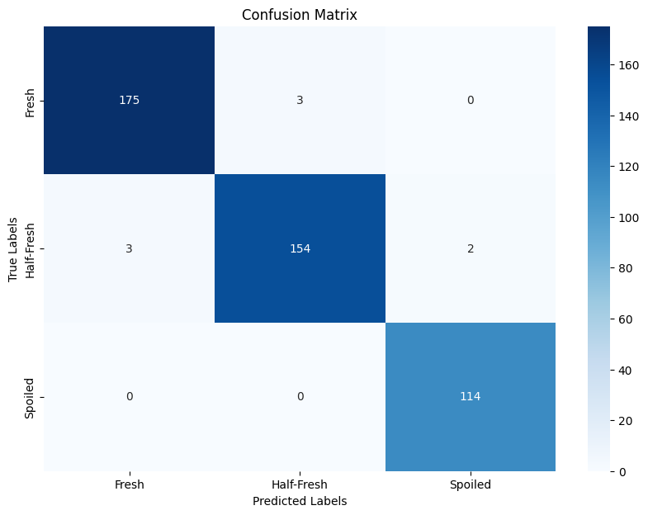
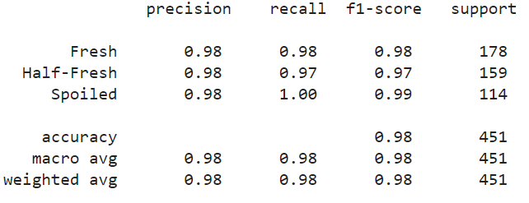
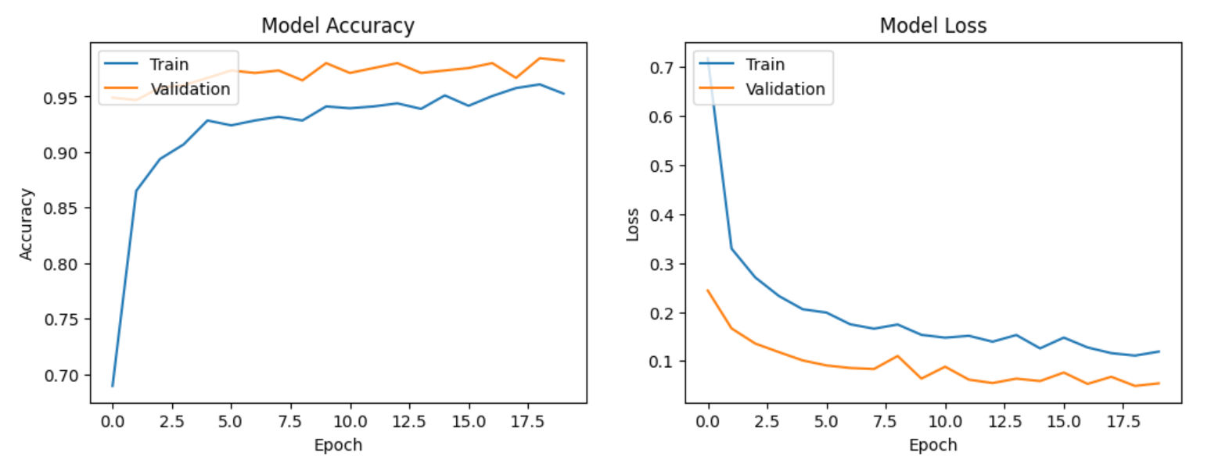
Model Selection and Performance (DenseNet121)
F3 Score
1.00
Epochs: 20
Dropout: 0.5
Activation: ReLu
Optimizer: Adam
Notes:
The model accurately identifies "Fresh" and "Spoiled" classes with almost perfect precision and recall.
Minimal misclassifications occur, showcasing the model’s high accuracy across all classes.
F3 Score: 1.00, indicating exceptional recall performance, reducing the risk of misclassification to almost zero.
Both training and validation loss decrease steadily and stabilize, suggesting effective learning with minimal overfitting.
Both training and validation accuracy show consistent improvement and stabilization, indicating robust learning and generalization.
The F3 score might be high due to specific patterns in the data that the model has learned to exploit, which might not be apparent in the accuracy/loss curves.
The F3 score focuses on the harmonic mean of precision and recall, with more weight on recall. If the model is very good at correctly identifying true positives and has a high recall, the F3 score will be high. However, this doesn't guarantee that the overall loss is minimized or that the accuracy is maximized.

Slide 19
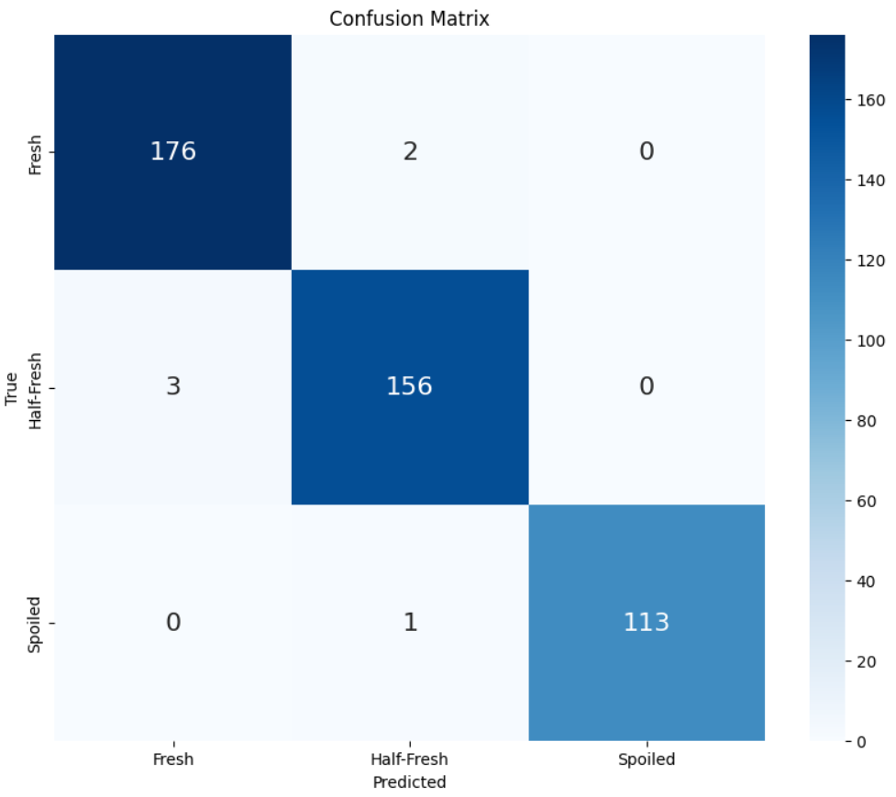
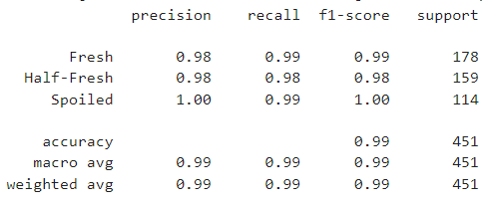
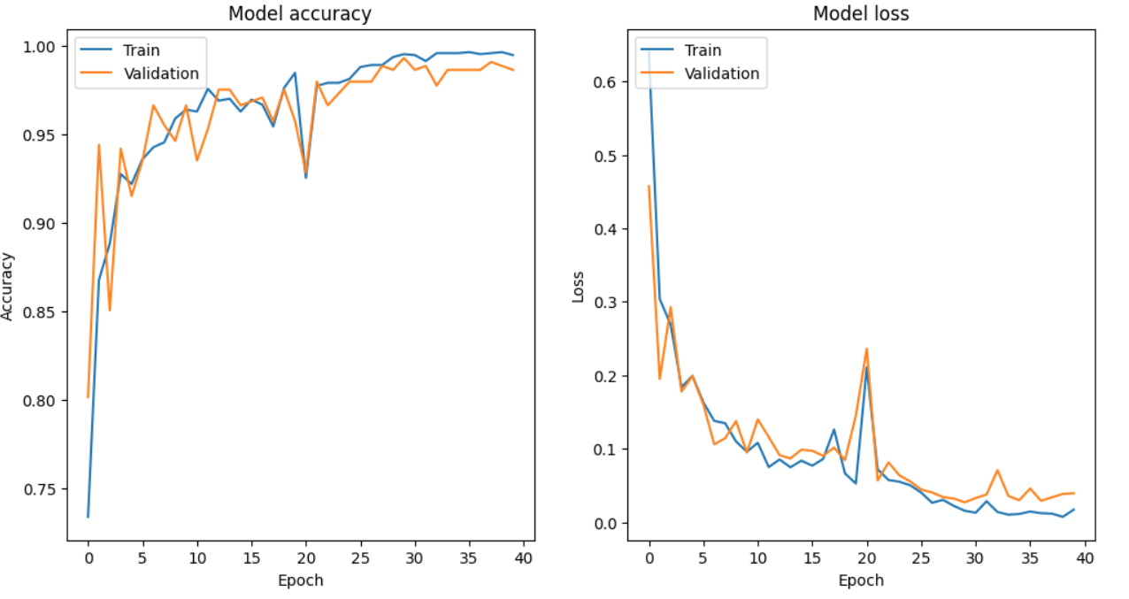
Model Selection and Performance (Xception)
F3 Score
0.99
Epochs: 20
Activation: ReLu
Optimizer: Adam
Notes:
The model accurately identifies "Fresh" and "Spoiled" classes with almost perfect precision and recall.
Minimal misclassifications occur, showcasing the model’s high accuracy across all classes.
Both training and validation accuracy show consistent improvement and stabilization, indicating robust learning and generalization.
Both training and validation loss decrease steadily and stabilize, suggesting effective learning with minimal overfitting.

Slide 20
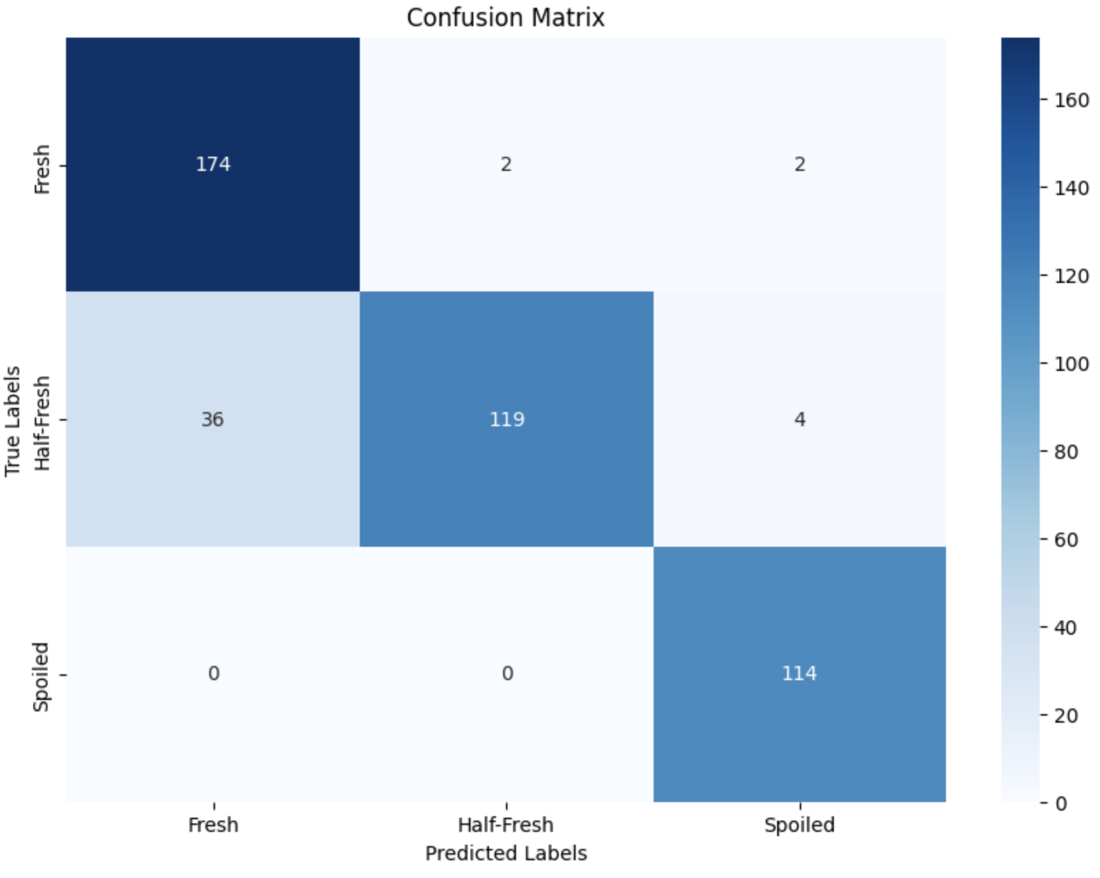
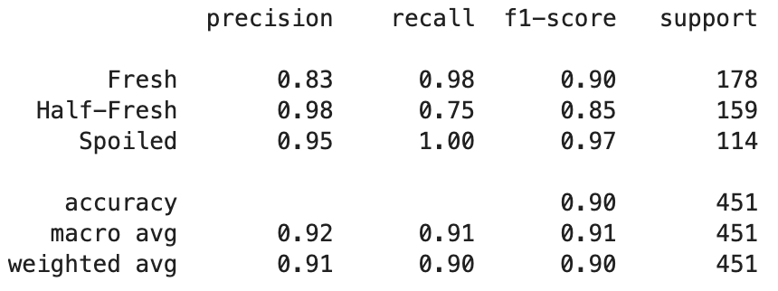
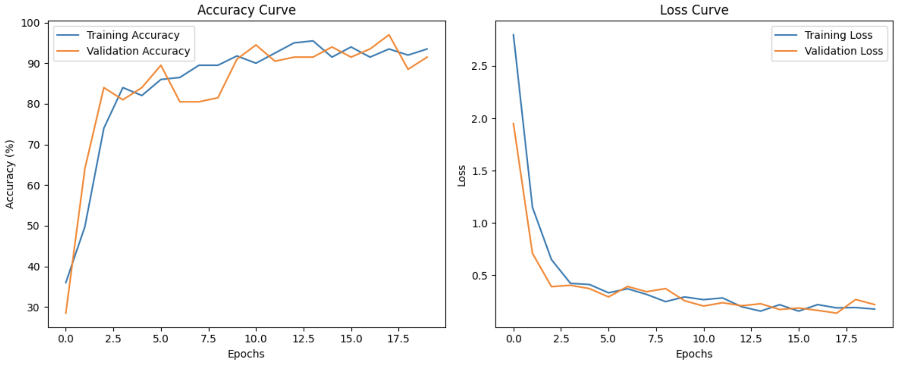
Model Selection and Performance (VGG 16)
F3 Score
0.99
Epochs: 20
Activation: ReLu
Optimizer: Adam
Notes:
The model performs well in identifying "Fresh" and "Spoiled" classes with minimal misclassifications.
Some misclassifications occur with the "Half-Fresh" class, where instances are often identified as "Fresh."
F3 Score: 0.99, indicating excellent recall performance, minimizing the risk of misclassification.
Accuracy Curve:
Both training and validation accuracy show consistent improvement and stabilization, indicating robust learning and generalization.
Loss Curve:
Both training and validation loss decrease steadily and stabilize, suggesting effective learning with minimal overfitting.
VGG16 is known for its very deep architecture, constructed using small (3x3) convolution filters. Despite having a large number of parameters, it has been influential in the development of other models.
The F3 score might be high due to specific patterns in the data that the model has learned to exploit, which might not be apparent in the accuracy/loss curves.
The F3 score focuses on the harmonic mean of precision and recall, with more weight on recall. If the model is very good at correctly identifying true positives and has a high recall, the F3 score will be high. However, this doesn't guarantee that the overall loss is minimized or that the accuracy is maximized

Slide 21

Fine Tuning of VGG 16
Model | Class Weights | Data Augmentation | Model Architecture | Unfreezing Layers | Scheduler | Optimizer | Training Strategy
Basic VGG 16 | No class weights were used | No data augmentation | One dense layer of 128 units | All VGG layers were frozen | Fixed learning rate | Adam | 20 epochs
Improved VGG 16 | Class Weights: {'Fresh':0.89629, 'Half-Fresh': 0.96031, 'Spoiled': 1.18627} Added computation of class weights to handle class imbalance | 1. Shear 2. Zoom 3. Rotation 4. Width and height shifts flips 5. Brightness adjustment | 1. Dense layers of 1024 and 512 units 2. Batch normalization 3. Dropout layers for regularization (0.5) | Unfroze the last 8 layers of the VGG base model for fine-tuning | The learning rate is adjusted using an exponential decay formula: lr * np.exp(-0.1) | Adam | 30 epochs
Notes:
Augmentation
Add custom layers on top of the basic model,eg.relu,BatchNormalization
Define early stopping and learning rate reduction on plateau callbacks
Train the model with class weights
Add epochs=30, increase batch_size=50
Add scheduler
Keep using adam optimizer

Slide 22



Fine Tuning of the selected Machine Learning Model (Results)
F3 Score
1.00
Epochs: 30
Dropout: 0.5
Activation: ReLu
Optimizer: Adam

Slide 23




Comparison to ChatGPT4
ChatGPT-4
F3 Score
0.43
ChatGPT-4o
F3 Score
0.57
ChatGPT is not a CNN and not designed for image classification and cannot be compared to other deep learning models. It serves as a common reference tool.
Notes:
ChatGPT is primarily a text-based language model

Slide 24

Summary Table
Model | Precision | Recall | Accuracy | F1 Score | F2 Score | F3 Score
Naïve Bayes | 0.51 | 0.71 | 0.60 | 0.59 | 0.66 | 0.68
Logistic Regression | 0.67 | 0.53 | 0.63 | 0.59 | 0.55 | 0.54
Random Forest | 0.74 | 0.66 | 0.69 | 0.70 | 0.67 | 0.67
ANN (Self-Built) | 0.69 | 0.68 | 0.53 | 0.68 | 0.68 | 0.68
CNN (Self-Built) | 0.70 | 0.93 | 0.78 | 0.80 | 0.87 | 0.90
CNN Fine-Tuned (Self-Built) | 1.00 | 0.71 | 0.83 | 0.83 | 0.75 | 0.73
ResNET50 | 0.78 | 0.89 | 0.71 | 0.83 | 0.87 | 0.88
EfficientNetB0 | 1.00 | 0.98 | 0.88 | 0.99 | 0.98 | 0.98
DenseNet121 | 0.98 | 1.00 | 0.98 | 0.99 | 1.00 | 1.00
Xception | 1.00 | 0.99 | 0.99 | 1.00 | 0.99 | 0.99
VGG16 | 0.95 | 1.00 | 0.90 | 0.97 | 0.99 | 0.99
VGG16 Fine-Tuned | 1.00 | 1.00 | 0.98 | 1.00 | 1.00 | 1.00
ChatGPT-4* | 0.81 | 0.41 | 0.50 | 0.55 | 0.45 | 0.43
ChatGPT-4o* | 0.86 | 0.55 | 0.57 | 0.67 | 0.59 | 0.57
*ChatGPT model is not optimized for image classification task

Slide 25


Conclusion
Deep Learning Model has better performance for Image Classification Task as seen in Accuracy and F1/2/3 scores
VGG16 Fine-tuned > CNN Self-Built >>> ANN > Traditional Models

Slide 26
Recent Cases
“… users who reported being poisoned from eating spoiled beef… in Argentina, presented symptoms such as vomiting, diarrhoea, fever and abdominal pain, therefore they had to be treated by medical personnel.”
Sale of spoiled meat causes hundreds of food poisoning cases in Syria’s Kobani
Source: Sale of spoiled meat causes hundreds of food poisoning cases in Syria’s Kobani (Aug 2020)
Source: What are the health risks of consuming rotten meat? (Jan 2024)

Slide 27


Model Selection and Performance (VGG 16)
Yilin
I have updated the VGG16 results in the next slide
Class Weights: {0: 0.8445692883895131, 1: 0.9454926624737946, 2: 1.3187134502923976}

Slide 28
Summary Table
Model | Precision | Recall | Accuracy | F1 Score | F2 Score
Naïve Bayes | 0.61 | 0.60 | 0.60 | 0.59
Logistic Regression | 0.63 | 0.63 | 0.63 | 0.63
Random Forest | 0.69 | 0.69 | 0.69 | 0.69
ANN (Self-Built) | 0.54 | 0.53 | 0.53 | 0.48
CNN (Self-Built) | 0.79 | 0.78 | 0.78 | 0.78
CNN Fine-Tuned (Self-Built) | 0.85 | 0.83 | 0.83 | 0.83
resNET50 | 0.75 | 0.71 | 0.71 | 0.69
Efficient Net | 0.89 | 0.88 | 0.88 | 0.88
DenseNet121 | 0.98 | 0.98 | 0.98 | 0.98
Xception
VGG16 | 0.91 | 0.90 | 0.90 | 0.90
VGG16 Fine-Tuned | 0.98 | 0.98 | 0.98 | 0.98
ChatGPT-4* | 0.48 | 0.50 | 0.50 | 0.40
ChatGPT-4o* | 0.54 | 0.57 | 0.57 | 0.51
*ChatGPT model is not optimized for image classification task

Slide 29

VGG Architecture
Phoebe / Kathy
Notes:
It is one of the popular algorithms for image classification and is easy to use with transfer learning.
The 16 in VGG16 refers to 16 layers that have weights. In VGG16 there are thirteen convolutional layers, five Max Pooling layers, and three Dense layers which sum up to 21 layers but it has only sixteen weight layers i.e., learnable parameters layer.
VGG16 takes input tensor size as 224, 244 with 3 RGB channel
Most unique thing about VGG16 is that instead of having a large number of hyper-parameters they focused on having convolution layers of 3x3 filter with stride 1 and always used the same padding and maxpool layer of 2x2 filter of stride 2.
The convolution and max pool layers are consistently arranged throughout the whole architecture
Conv-1 Layer has 64 number of filters, Conv-2 has 128 filters, Conv-3 has 256 filters, Conv 4 and Conv 5 has 512 filters.
Three Fully-Connected (FC) layers follow a stack of convolutional layers: the first two have 4096 channels each, the third performs 1000-way ILSVRC classification and thus contains 1000 channels (one for each class). The final layer is the soft-max layer.

Slide 30
Segment | Presenter | What to be presented
Introduction | David | Business Context Why is it important
Approach & Pre-Processing Traditional Model Result | Samson | Describe our approach & the Performance Metrics Share the results (F3 score for the 3 simple models)
Deep Learning Models | Kathy | Explain the model briefly & share the results (F3 score)
Pre-Trained Models | Phoebe | Mention about the model briefly & share the results (F3 score)
Fine Tuning of Model & Summary | Yilin | Share the result of the Fine-tuned model (F3 score) Describe that ChatGPT score is poor Share the summary result Conclusion

Slide 31

CNN Architecture
Notes:
It is one of the popular algorithms for image classification and is easy to use with transfer learning.
The 16 in VGG16 refers to 16 layers that have weights. In VGG16 there are thirteen convolutional layers, five Max Pooling layers, and three Dense layers which sum up to 21 layers but it has only sixteen weight layers i.e., learnable parameters layer.
VGG16 takes input tensor size as 224, 244 with 3 RGB channel
Most unique thing about VGG16 is that instead of having a large number of hyper-parameters they focused on having convolution layers of 3x3 filter with stride 1 and always used the same padding and maxpool layer of 2x2 filter of stride 2.
The convolution and max pool layers are consistently arranged throughout the whole architecture
Conv-1 Layer has 64 number of filters, Conv-2 has 128 filters, Conv-3 has 256 filters, Conv 4 and Conv 5 has 512 filters.
Three Fully-Connected (FC) layers follow a stack of convolutional layers: the first two have 4096 channels each, the third performs 1000-way ILSVRC classification and thus contains 1000 channels (one for each class). The final layer is the soft-max layer.

